Slide 1
Clique Cover Problem
Implementation of Algorithms
Result Analysis
Group No: 10
Student ID:
1505002
1505044
1505057
1505097
1505101

Slide 2
Vertex Clique Cover
Clique Cover Decision Problem:
Given a graph G(V, E) and a number K, we need to answer yes or no if we can partition V(G) in K cliques
Minimum Clique Cover Problem:
Given a graph G(V, E), we need to output the smallest number for which clique cover exists. This number is called the clique cover number.
In this presentation we will discuss some algorithms regarding these problems. As already discussed, we can derive a solution for clique cover decision problem from clique cover number and vice versa.

Slide 3
Let’s look at an example...
C
D
A
B
F
E
G
I
H

Slide 4
Let’s look at a scenario...
C
D
A
B
F
E
G
I
H

Slide 5
Algorithms We Have Covered
Brute Force and Exact Algorithm
Sum over Subset DP
Approximation Algorithms
Heuristic Metaheuristic Algorithms
Tabu Search for Vertex Clique Cover
Greedy Clique Cover
Iterative Greedy Clique Cover

Slide 6
Dataset
10 Randomly generated graphs
DIMACS ( Center for Discrete Mathematics and Theoretical Computer Science)
Implementation challenge for NP-hard problems (1993)
21 graphs with different edge density,nodes and edges

Slide 7
Dataset
Graph Name | Nodes | Edges
Gnp10_0.2.clq | 10 | 11
Gnp11_0.2.clq | 11 | 11
Gnp13_0.2.clq | 13 | 11
Gnp14_0.2.clq | 14 | 22
Gnp16_0.2.clq | 16 | 27
Gnp17_0.2.clq | 17 | 26
Gnp19_0.2.clq | 19 | 30
Gnp21_0.2.clq | 21 | 38
Gnp22_0.2.clq | 22 | 51
Gnp24_0.2.clq | 24 | 52

Slide 8
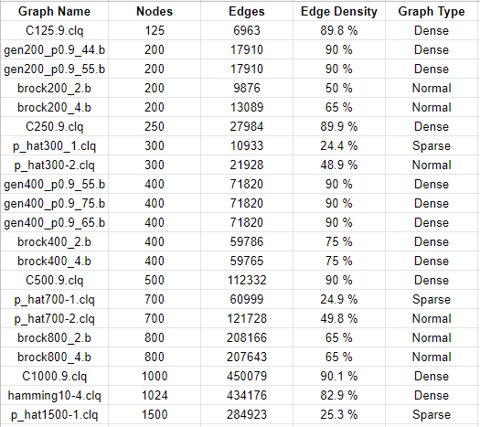

Slide 9
Brute Force Algorithm
Step 1 : Find the power set of V where V is the set of vertices of graph G.
Step 2 : Take an empty list S.
Step 3 : Take every element(which is actually a subset of V) of P(V) and check whether it’s a complete subgraph or clique then add this to list S otherwise skip the element.
Step 4 : Find all possible subsets of S of size k.
Step 5 : Take every subsets and check whether it covers all vertices of V or not.

Slide 10
Brute Force Algorithm
Step 1 : Find the power set of V where V is the set of vertices of graph G.
Step 2 : Take an empty list S.
Step 3 : Take every element(which is actually a subset of V) of P(V) and check whether it’s a complete subgraph or clique then add this to list S otherwise skip the element.
Step 4 : Find all possible subsets of S of size k.
Step 5 : Take every subsets and check whether it covers all vertices of V or not.
The time complexity of brute force algorithm is O(n2^{kn})

Slide 11
Brute Force Algorithm (DP Solution)
Improvement of previous algorithm
The number of configurations tested is way smaller
Able to stop its exploration of the solution if it is sure that there won't be any viable & better solution with the given configuration
Slightly faster !!!!

Slide 12
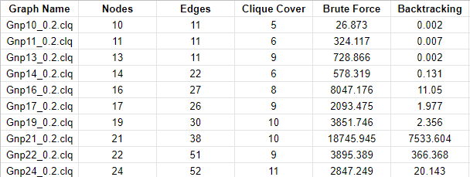
Runtime comparison (in second)

Slide 13
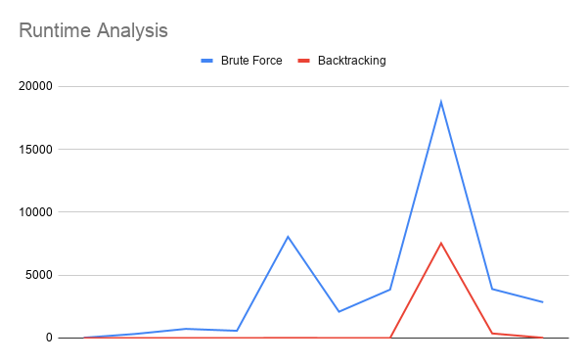

Slide 14
Exact DP Algorithm
Find all Cliques.
For each subset S of N vertices count the number of clique which are subset of this subset using SOS dp.
Calculate the number of K size subset of all clique set with repetition which misses at least one vertice.
If the above number of less than (total_clique)^{k}, the we can cover the graph with k clique.

Slide 15
Greedy Clique Covering (GCC)
Input: graph G = [V, E]
permutation P = [P₁, P₂, ..., P_{n}] of vertices in V
Output: clique covering S of G
Algorithm:
for c = 1..n
sizes(c) = 0
for i = 1..n
j = P_{i}
c = find_equal(Γ(v_{j} , c), sizes(c))
V_{c} = V_{c} ∪ {v_{j}}
return S = {V₁, V₂, ..., V_{k}}

Slide 16
Iterative Greedy Clique Covering (IG)
Input: graph G = [V, E]
Output: clique covering S of G
Algorithm:
P = random permutation(1, 2, ..., n)
while stopping criterion is not met
{V₁, V₂, ..., V_{k}} = GCC(G, P)
with p_{rev} probability
P = [V_{k}, V_{k−1}, ..., V₁]
else
P = random permutation(V₁, V₂, ..., V_{k})
if ϑ(G) is known and k = ϑ(G)
return S = {V1, V2, ..., Vk}
return S = {V₁, V₂, ..., V_{k}}

Slide 17
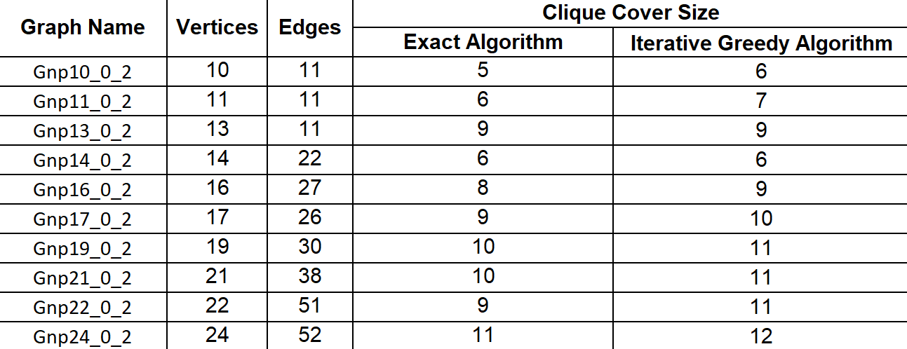
Performance Comparison for Small Graph

Slide 18
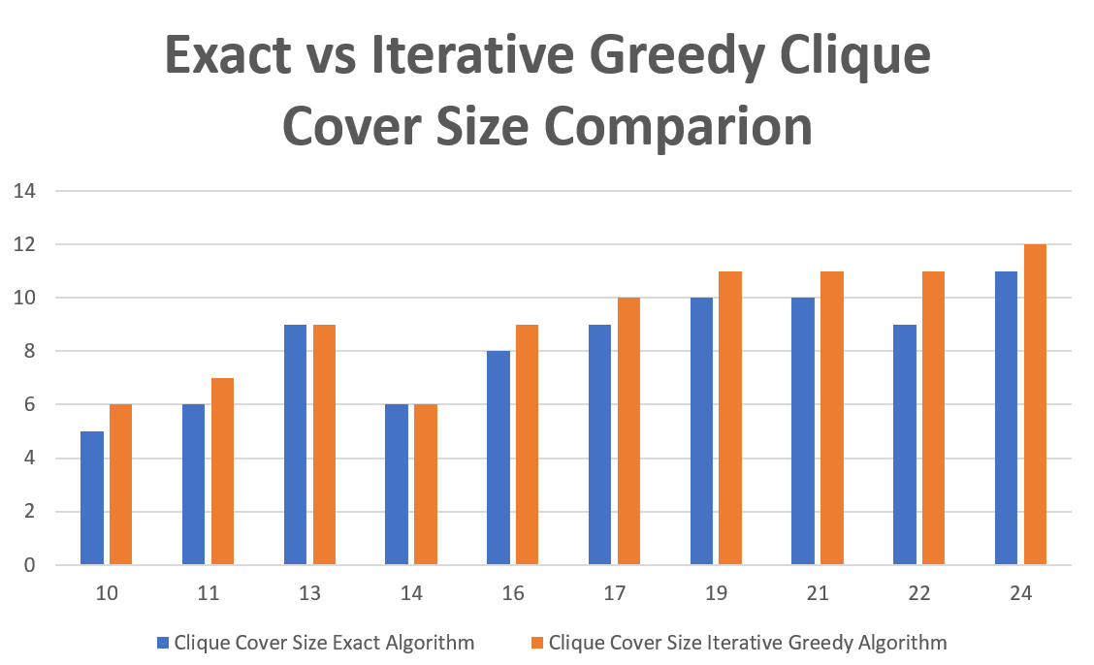

Slide 19
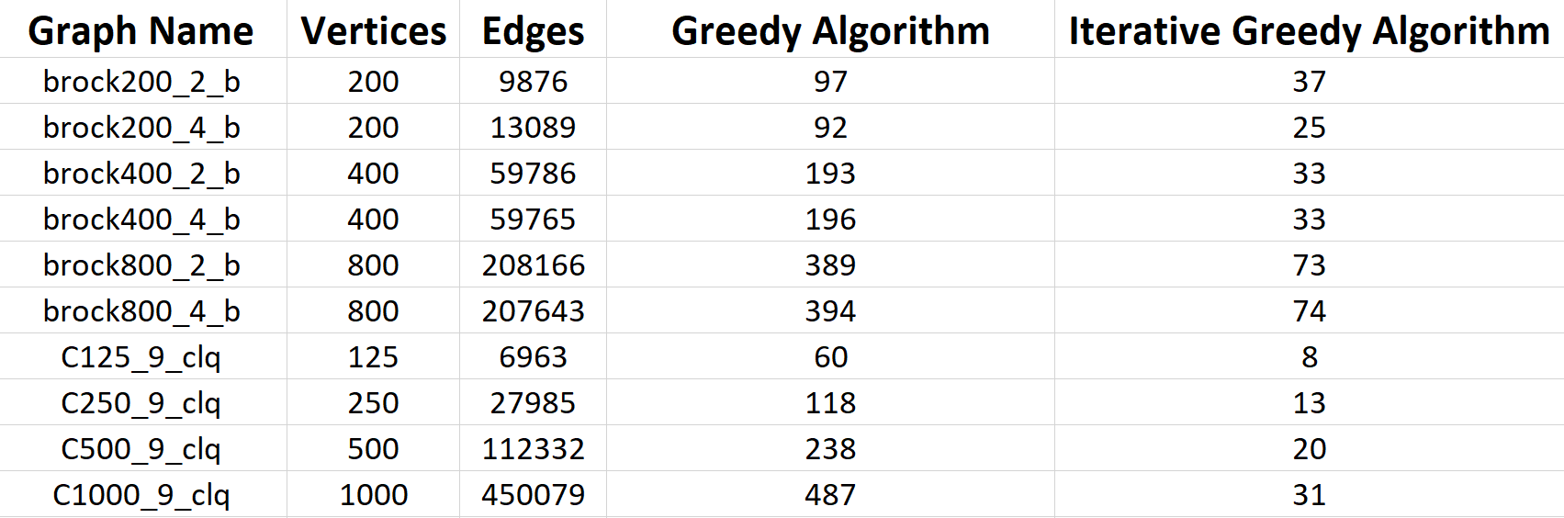
Performance Comparison on DIMACS Dataset

Slide 20
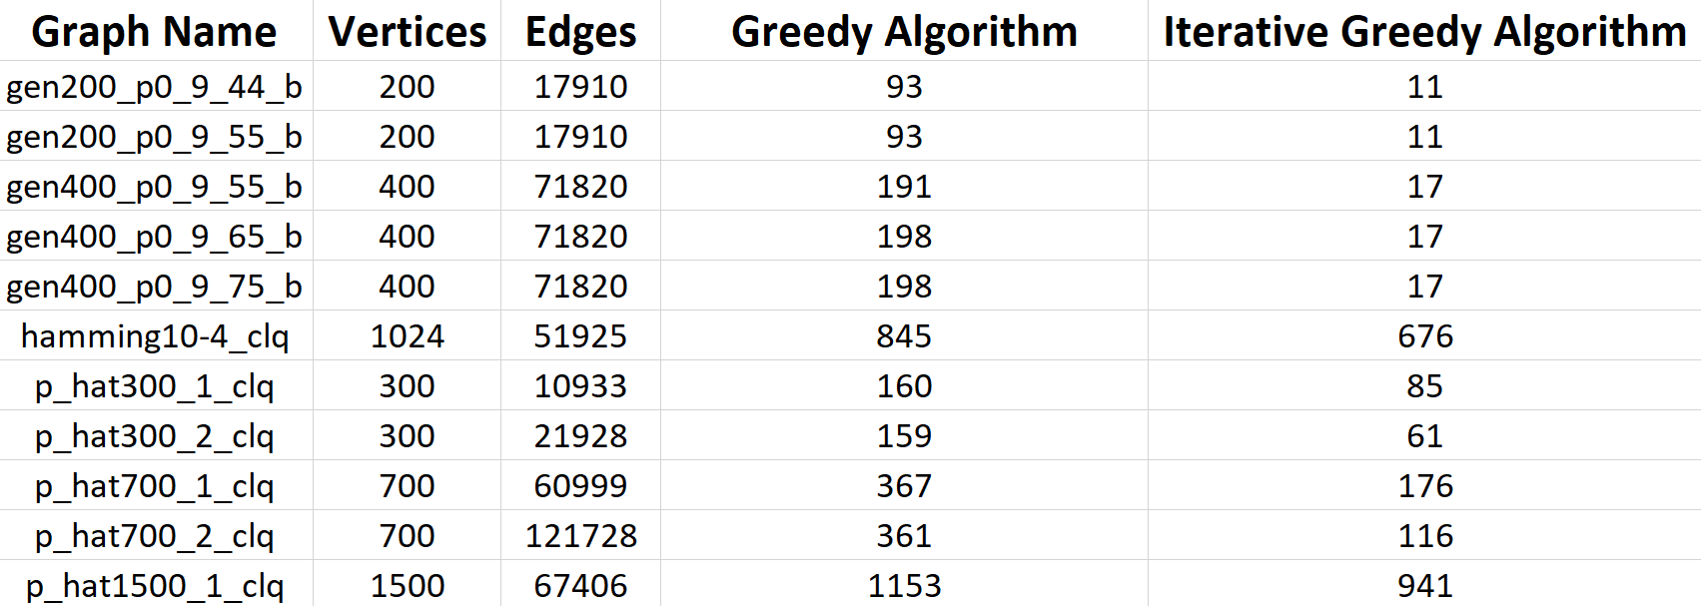
Performance Comparison on DIMACS Dataset(continue)

Slide 21
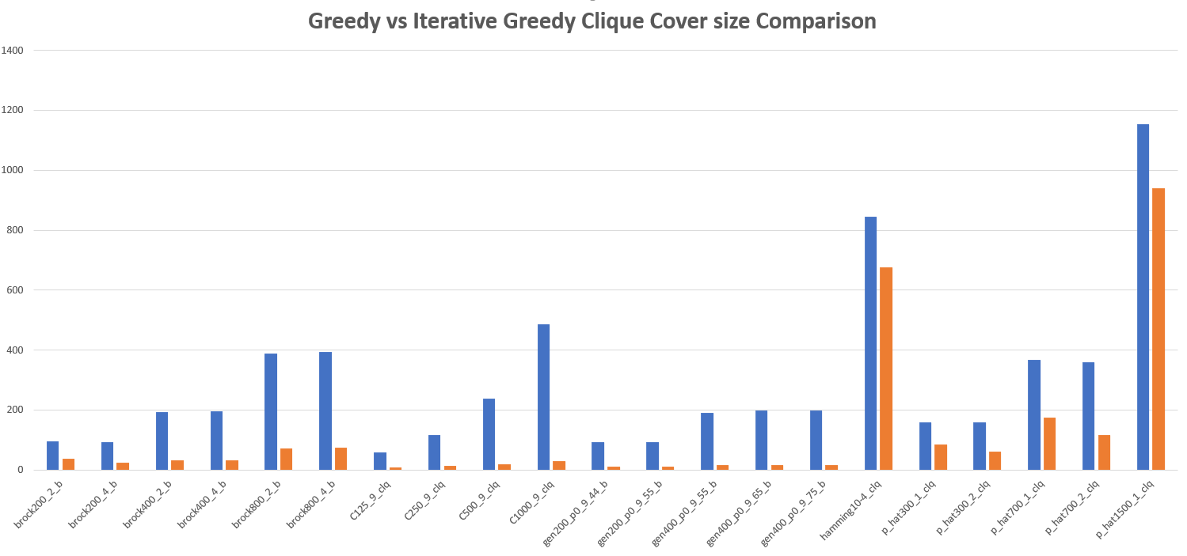
Greedy Clique Cover Size
Iterated Greedy Clique Cover Size

Slide 22
Thank You

